Slide 1


Student Adaptability level in Online Education
Presenter: Abhinav Jain
Instructor : Michael Cavallo
Date : 8/16/2023

Slide 2
Introduction
The COVID-19 pandemic forced educational institutions to shift to online learning abruptly.
Question raised about student adaptability to online education.
The report will explore the student’s adaptability level to online education during the pandemic.
Adaptability level is the dependent variable
Independent variable used Education level, Gender, Institution type, age, financial condition, class-duration

Slide 3
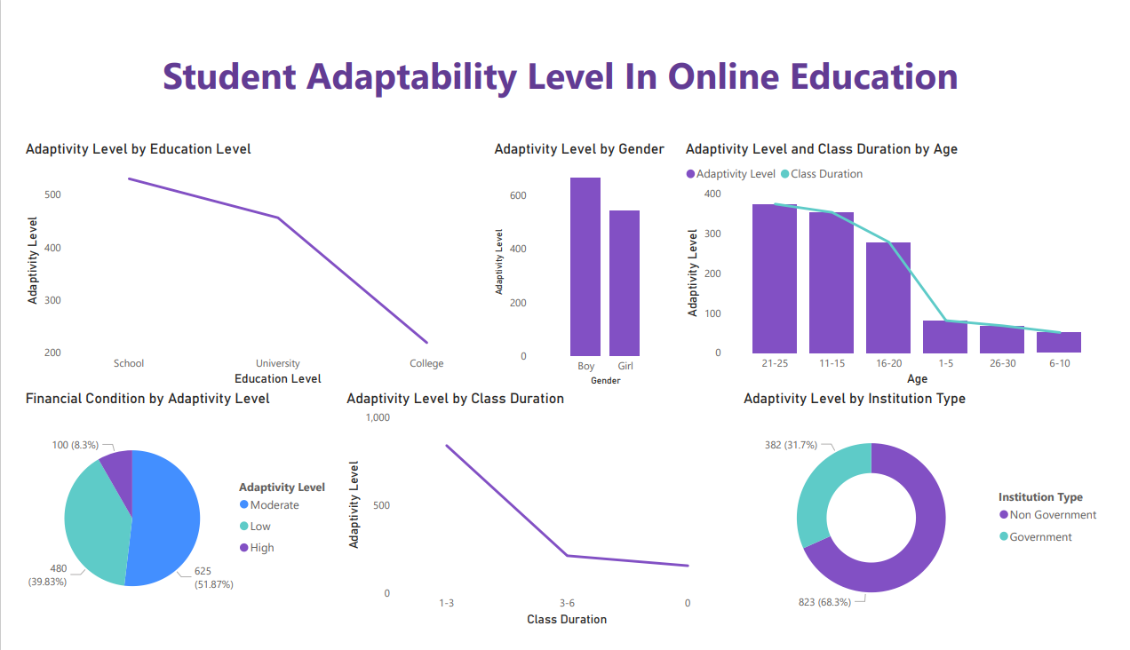
Dashboard
Dashboard
Problems
Findings
Conclusion

Slide 4
Problems
Lack of face-to-face interaction with classmates and instructors.
Difficulty managing time and staying motivated.
Distractions at home.
Technical difficulties.
Problems
Dashboard
Findings
Conclusion

Slide 5

Findings
Schools have the Highest adaptability.
Boys were more active during online education.
Age group between 21-25 was more involved for 1-3 class duration
Due to a lack of technology government institution was not able to adapt online education.
Findings
Dashboard
Problems
Conclusion

Slide 6
Conclusion
The adaptability of students was the key factor in determining the success of online learning.
Technological proficiency, learning preferences, home environments, time management, digital literacy, and interaction are all important factors in student adaptability.
Educational institutions and students have demonstrated resilience and resourcefulness in responding to the challenges of online learning.
The lessons learned from the COVID-19 pandemic will undoubtedly influence the future of education, and the ability of students to adapt and thrive in online learning will be critical.
Conclusion
Dashboard
Problem
Findings

Slide 7
Thank you

Slide 8
Questions or Recommendations?

Slide 9
References
[1] Students Adaptability Level in Online Education
Suzan
https://www.kaggle.com/datasets/mdmahmudulhasansuzan/students-adaptability-level-in-online-education/discussion/330166
[2] Adaptability and High School Students' Online Learning During COVID-19: A Job Demands-Resources Perspective
Martin et al.
https://www.frontiersin.org/articles/10.3389/fpsyg.2021.702163/full

